Slide 2
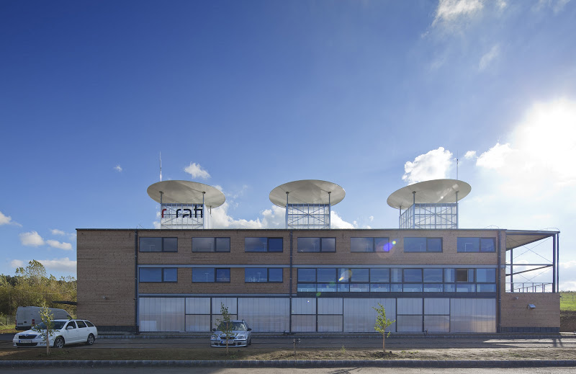
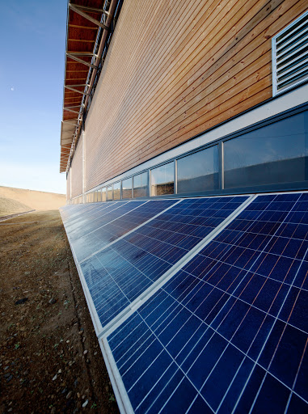
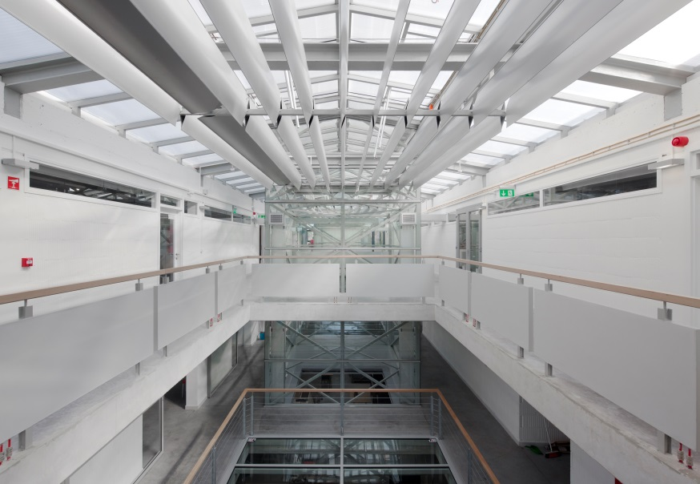
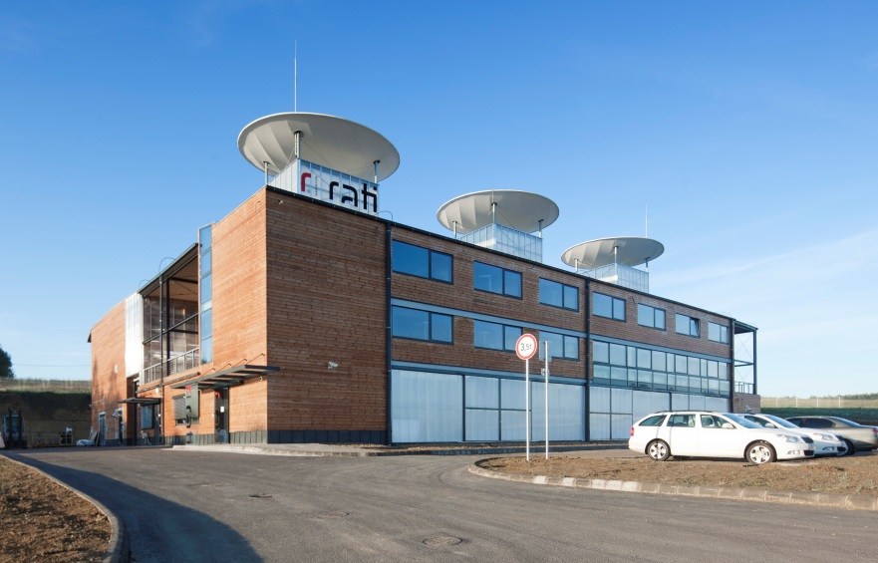

Slide 3
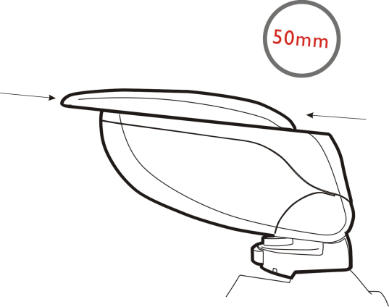
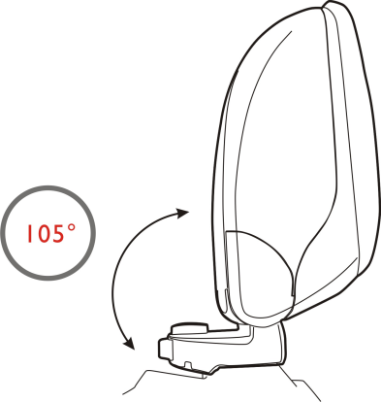
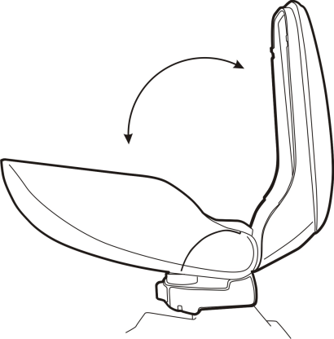
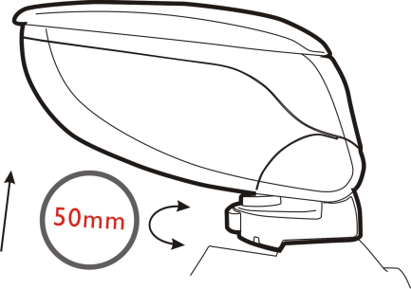
ПОДЛОКОТНИК ARMSTER 1
ОСНОВНЫЕ ХАРАКТЕРИСТИКИ

Slide 4
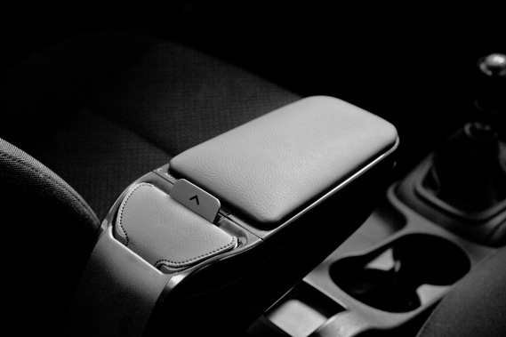

Slide 5
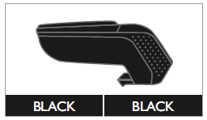
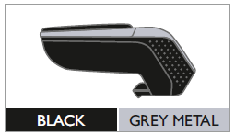

Slide 6
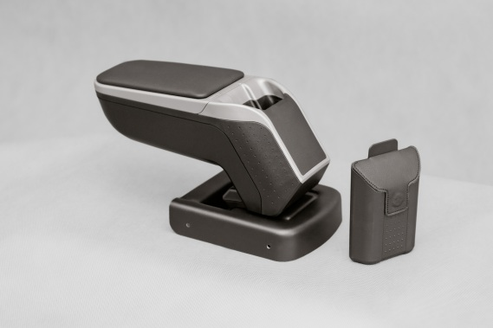

Slide 7
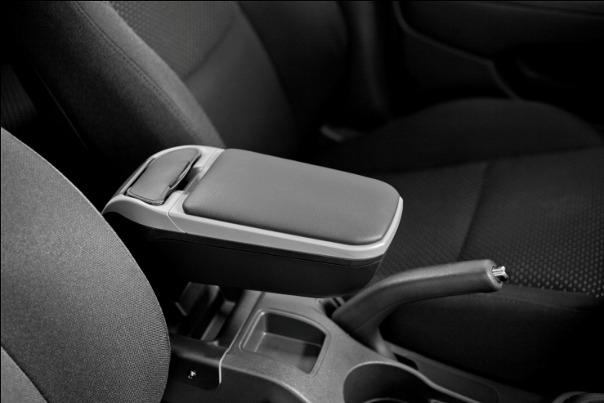
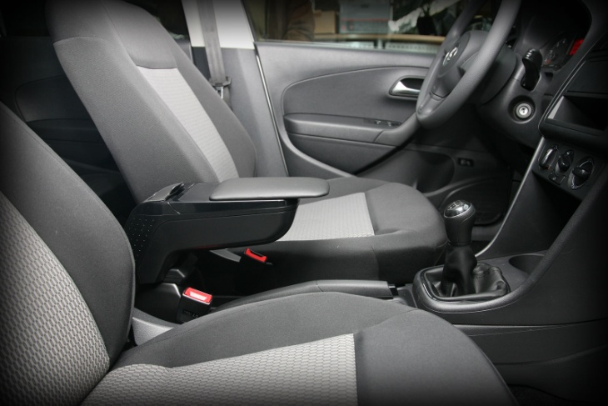
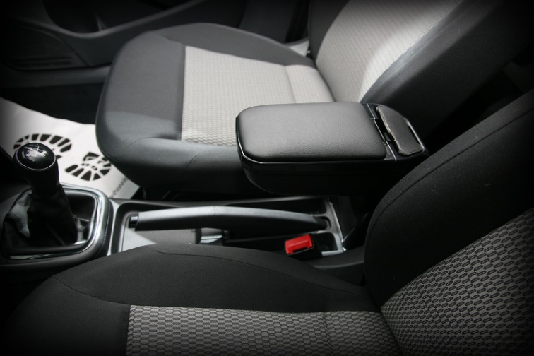
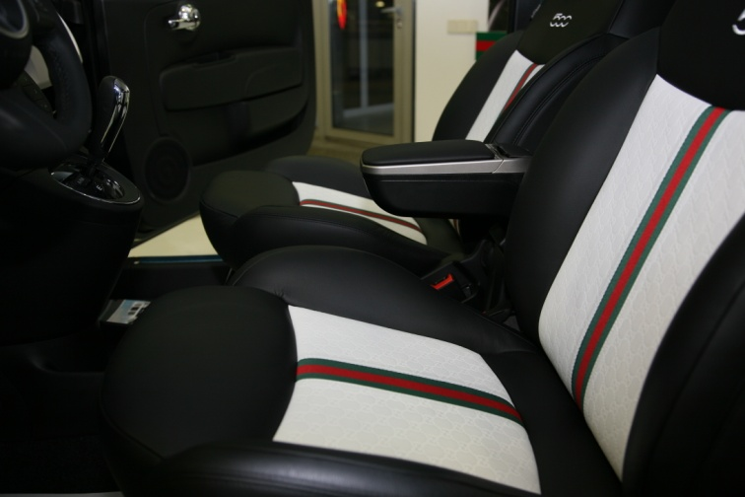

Slide 8
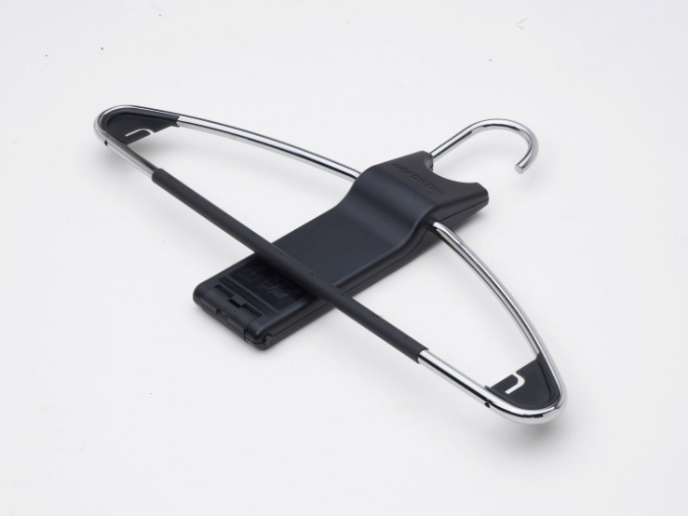
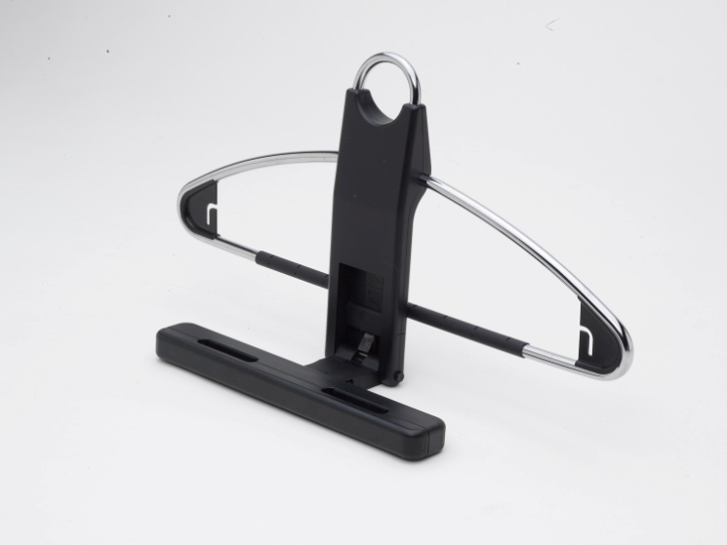
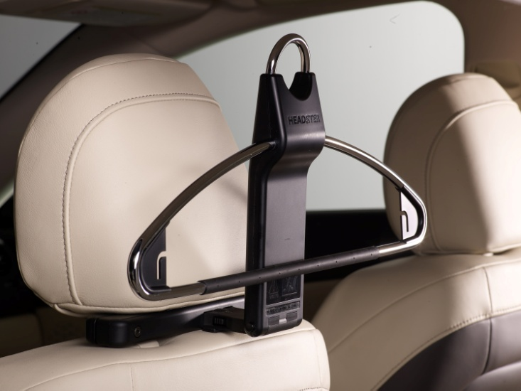
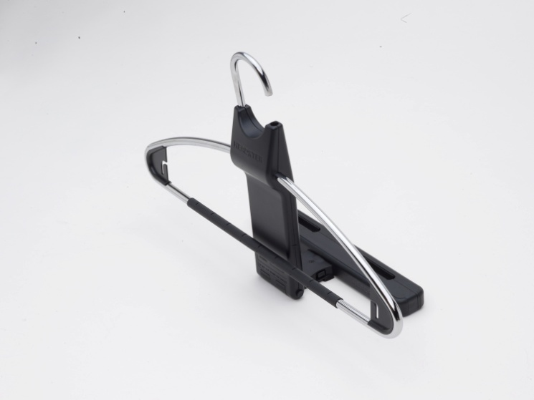
HEADSTER COSTUMER

Slide 9
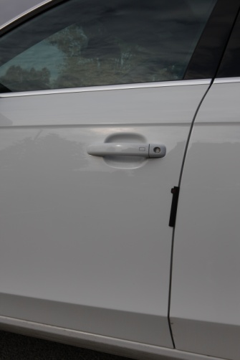
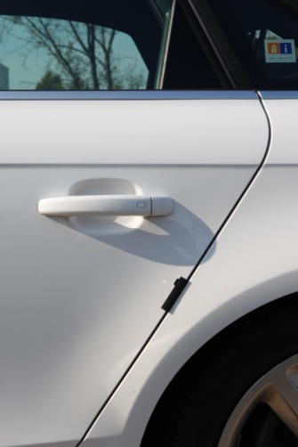
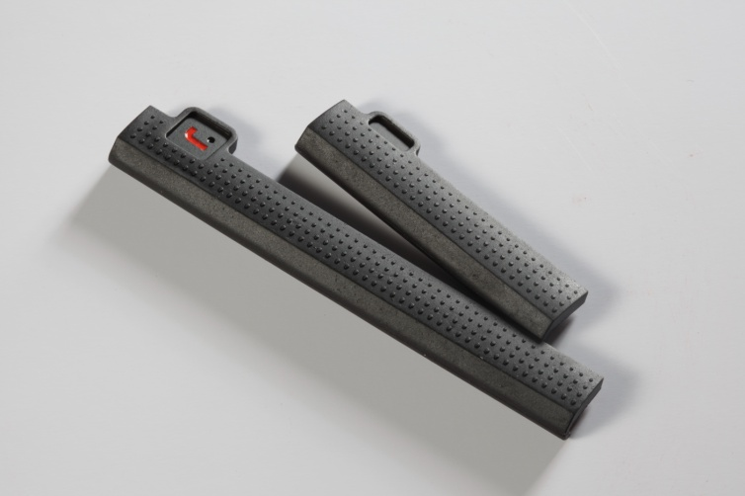
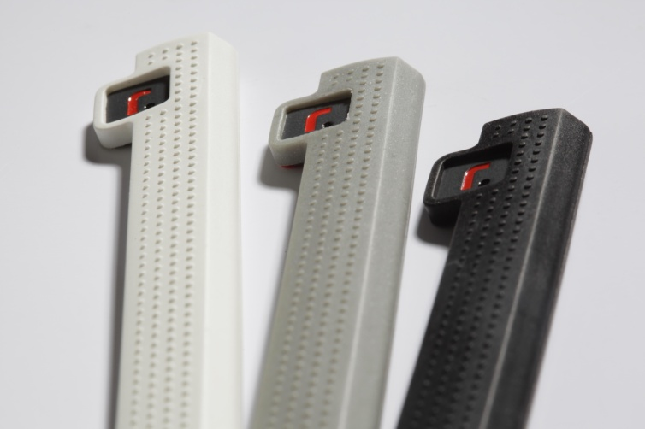
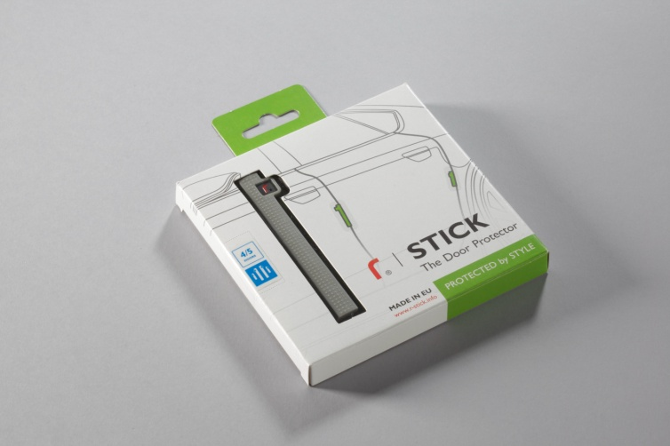
R-STICK THE DOOR PROTECTOR

Slide 10
присутствие в OE SUPPLY
S.C. AUTOMOBILE DACIA S.A.
by Dutch Spare Parts
ARMREST
Dacia Logan Art.Nr: 6001998264
Dacia Sandero Art.Nr: 6001998264
Dacia Lodgy Art.Nr: 8201149917
FORD EUROPE
by Polytec FOR GmbH
Ford Fiesta B299 Art.Nr: 1 683 263
Ford Focus C307 Art.Nr: 1 673 486
Ford Ka B420 Art.Nr: 1 746 608
Ford C-Max Art.Nr: 1 746 621
Ford Fusion B226 Art.Nr: 1 746 622
Ford Connect V227 Art.Nr: 1 746 620
PEUGEOT EUROPE CITROËN EUROPE
by Dutch Spare Parts
Peugeot 308 Art.Nr: 09645.66
Peugeot 207 Art.Nr: 09440.19
Citroen C4 Art.Nr: 09440.15
IRMSCHER AUTOMOBILEBAU GMBH
by Polytec FOR GmbH
OPEL ASTRA J Art.Nr: 007 30 17072
OPEL CORSA D Art.Nr: 007 10 17070
OPEL ZAFIRA B Art.Nr: 007 31 17070
KIA MOTORS / HYUNDAI MOTORS
by Mobisparts Europe N.V.
COAT HANGER
Art.Nr: 66770ADE00
Art.Nr: 99770ADE00
MAGYAR SUZUKI ZRT.
SUZUKI SWIFT
SUZUKI SX4
SUZUKI SPLASH
SUZUKI IGNIS
UZ-DAEWOO AUTO CO.
DAEWOO NEXIA
DAEWOO MATIZ
NISSAN EUROPE

Slide 11
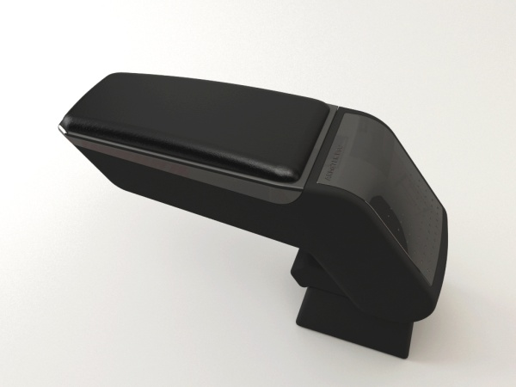
ARMSTER STANDART 2014

Slide 12
